Slide 1
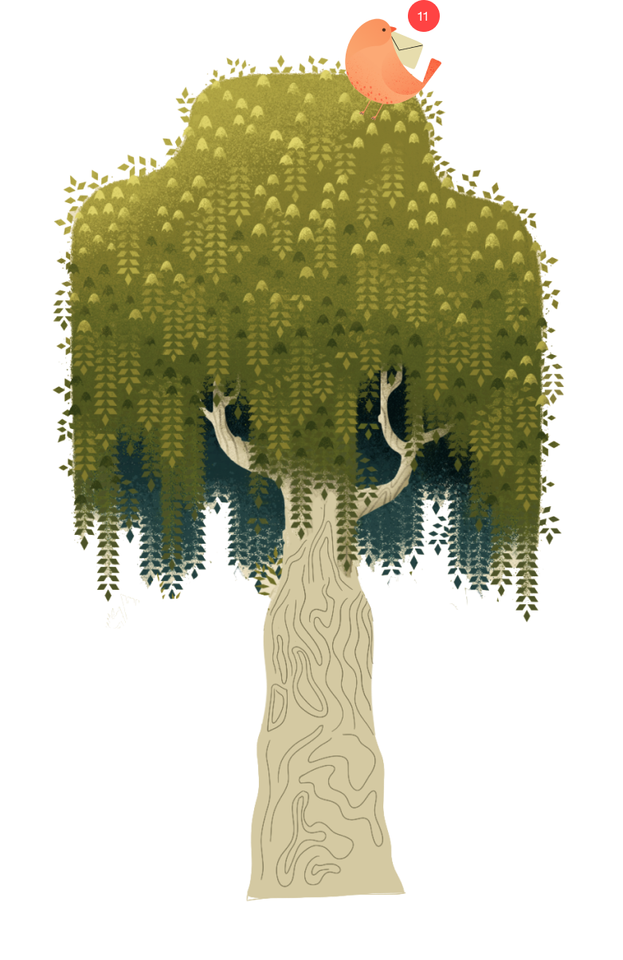
Wello
by Team EduCaution
Med-fi Prototype #2 & Usability Study

Slide 2
Team EduCaution
Neha C.
Victoria D.
Ingrid F.
Isha K.

Slide 3
Overview
01
02
03
04
05
Interface redesign #1
Overview of usability study
Test results
Interface redesign #2
Application of AI

Slide 4
01
Interface redesign #1

Slide 5
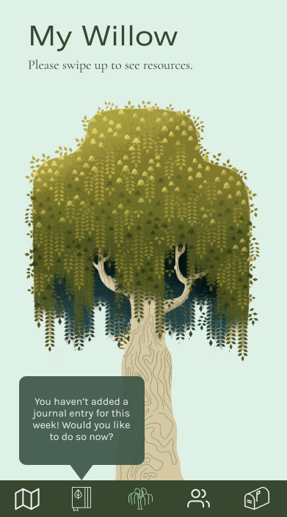
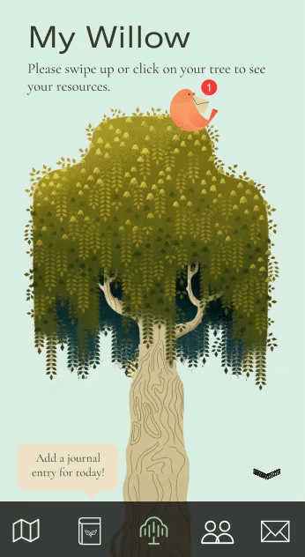
Wello home page
Add ability to tap the willow to see resources
Add animated arrow to scroll down to see resources
Add visuals to willow tree for a more personalized + cheerful feel
before
after

Slide 6
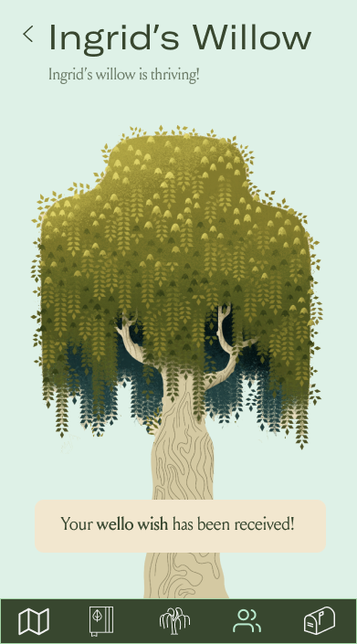
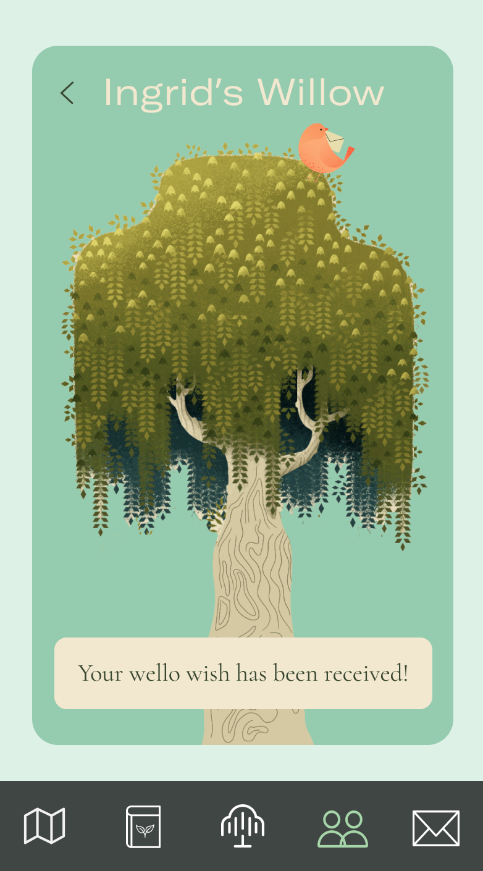
Friends’ willows
Display friends’ willows on colored “cards” to differentiate from your own willow
Display bird visual on friend’s willow to indicate your message was sent
before
after

Slide 7
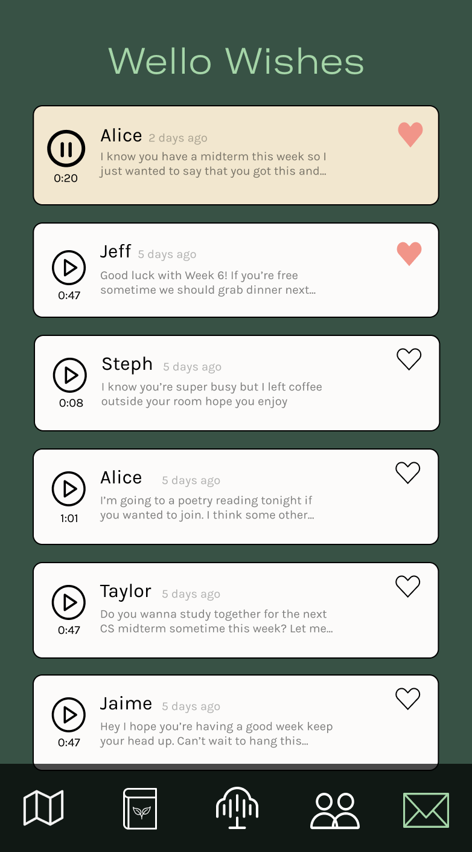
Wello wishes inbox
Stores all audio messages and automatically transcribes them
Ability to pin favorite messages

Slide 8
02
Overview of usability study

Slide 9
Study goals
Ensure that users understand the willow metaphor
Assess interest in and motivation to use the app
Receive feedback on visual design and usability issues

Slide 10
Study plan + procedure
Target users: university students
Recruit users via snowball sampling
Facilitate tasks
+ discussion
(Maze + Zoom)

Slide 11
Participants
+ 5 participants who completed our prototypes individually & anonymously
Jimmy, 24
Recent grad in public policy from a private university
P1
Vikas, 22
Senior studying CS at a UC
Dan, 18
Freshman studying music at a large public school
P2
P6
P3
P5
P4
Serene, 23
Graduate student at a state university
Michelle, 21
Sophomore at a small liberal arts college
Angela, 21
Junior at a large public school

Slide 12
Virtual user testing

Slide 13
03
Test results

Slide 14
Finding #1:
Some visual metaphors are still unclear
Not sure how the willow connects with mental health (P2, P4)
“What do the colors on the mood tracker represent?” (P1)

Slide 15
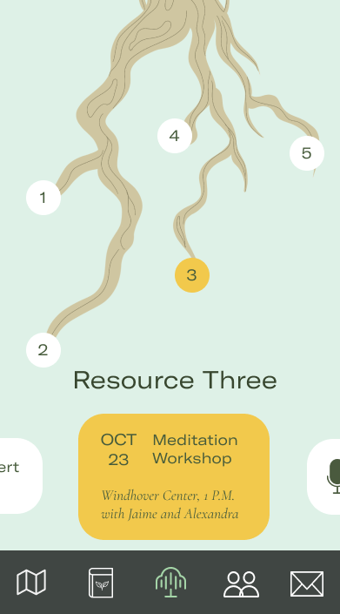
Finding #2:
Navigating to resources is still not intuitive
“I thought I had to click the down arrow, not scroll.” (P2)
“It wasn’t clear that I had to scroll down.” (P6)

Slide 16
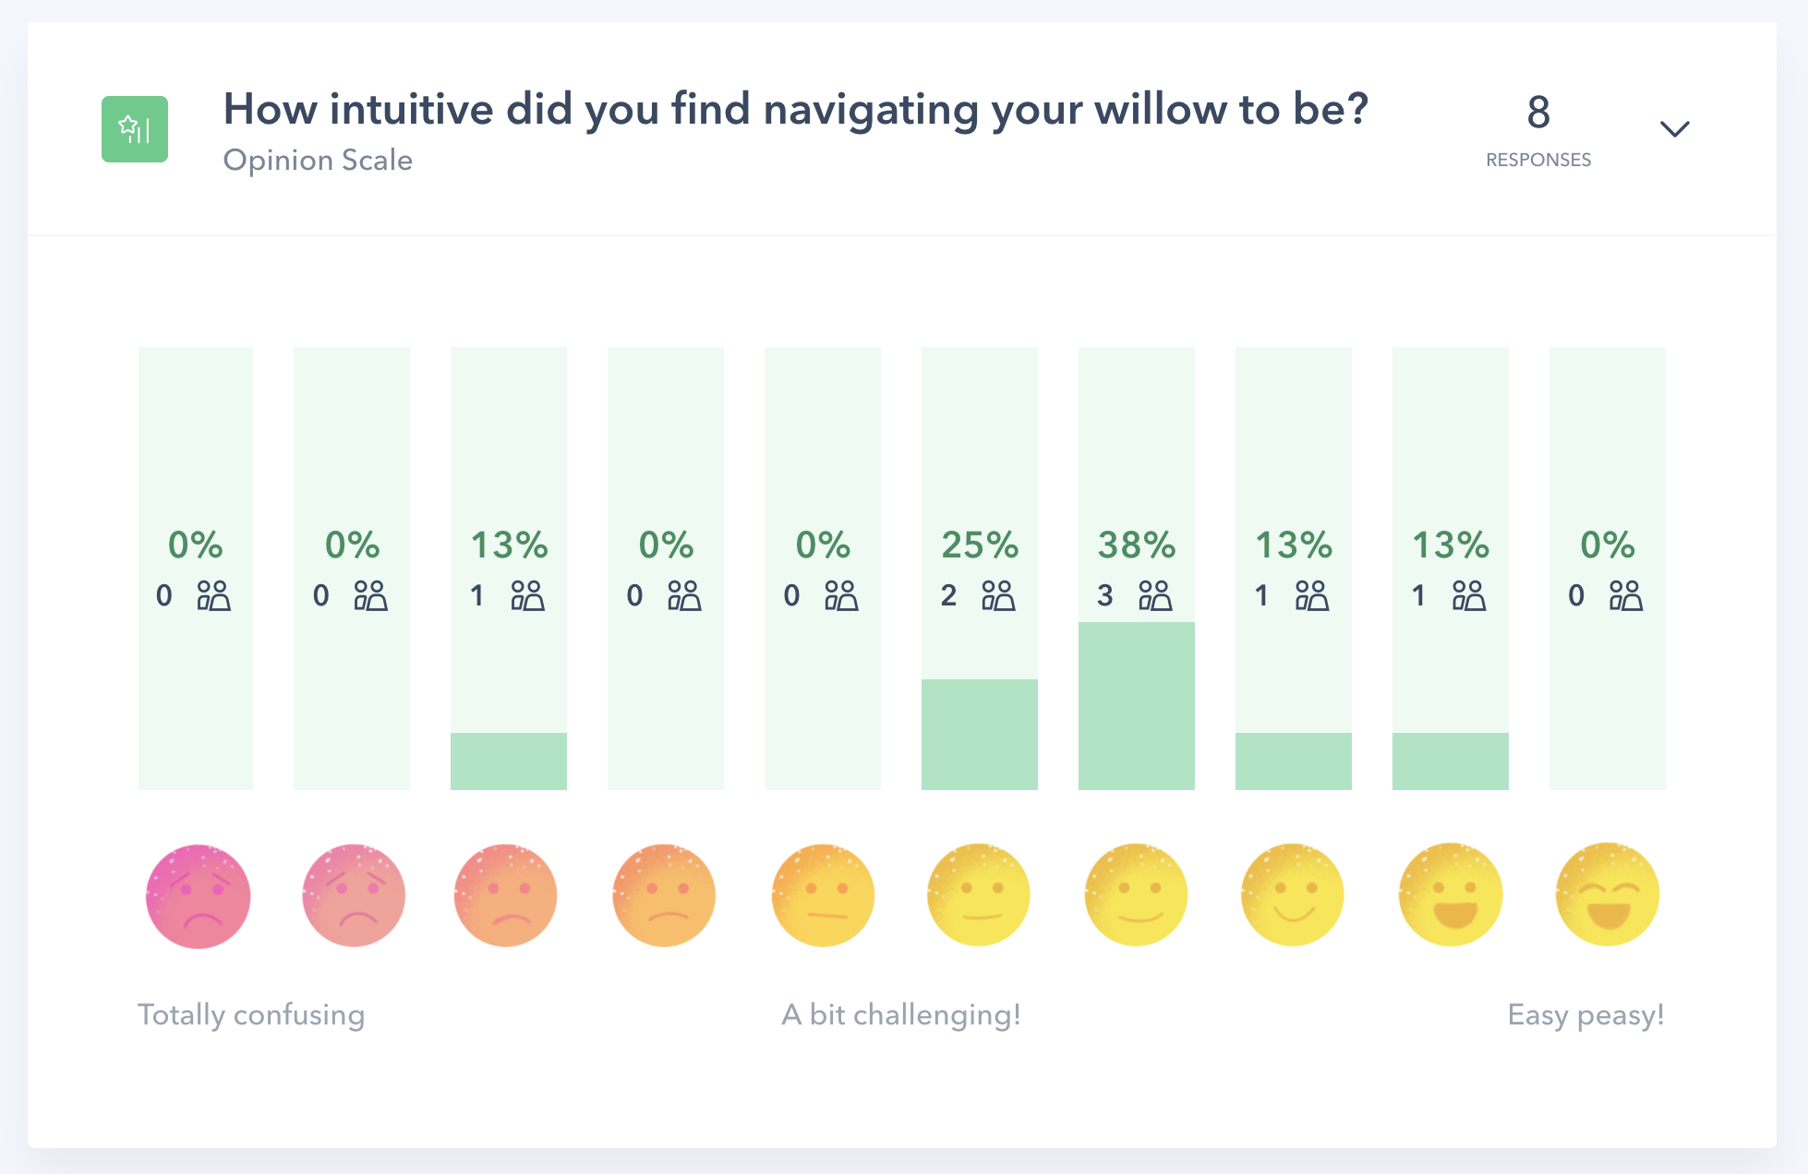
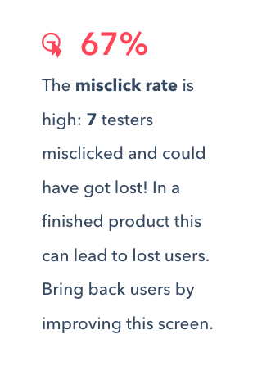
Finding #2:
Navigating to resources is still not intuitive

Slide 17
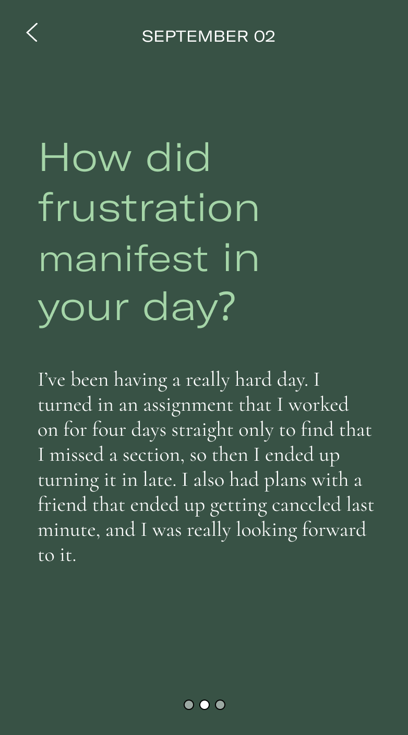
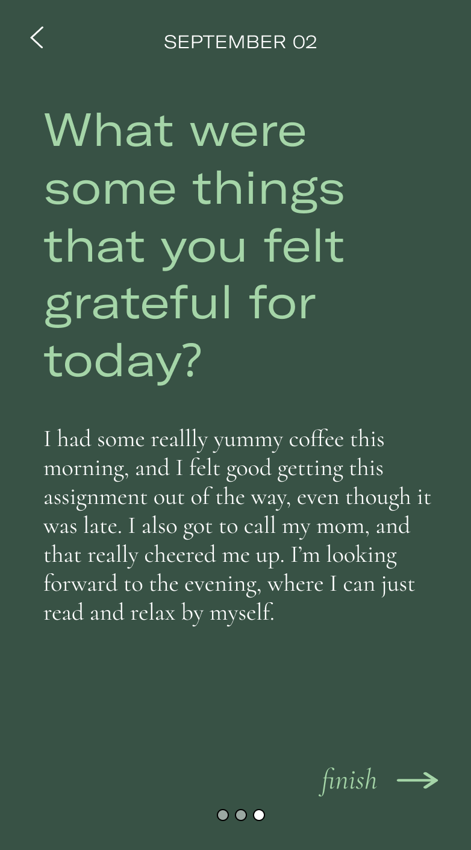
Finding #3:
Mobile journaling can feel tedious
“Journaling is too tedious on the phone. Maybe there should be a voice record option.” (P1)
“I already keep a physical journal, so I don’t know if I’d want to journal again on my phone.” (P5)

Slide 18
04
Interface redesign #2

Slide 19
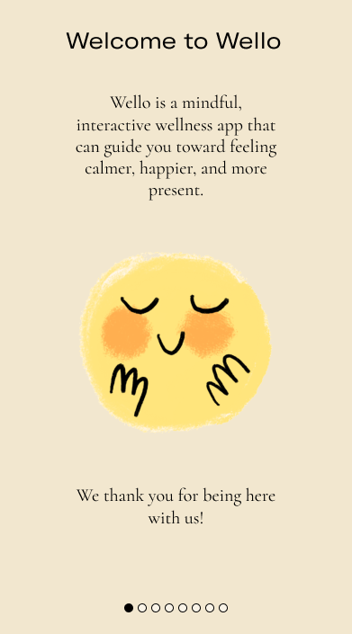
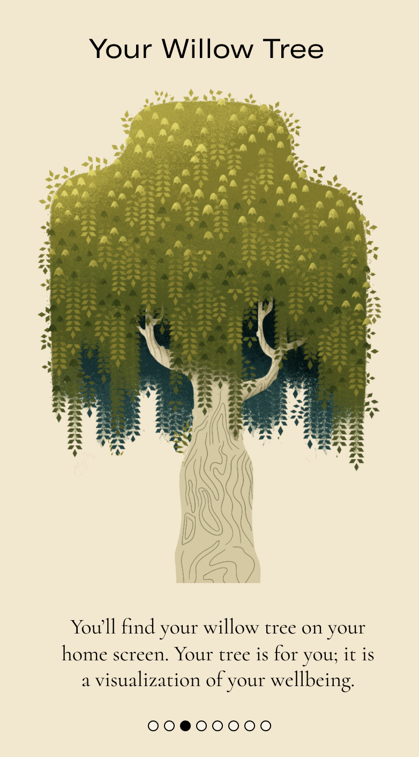
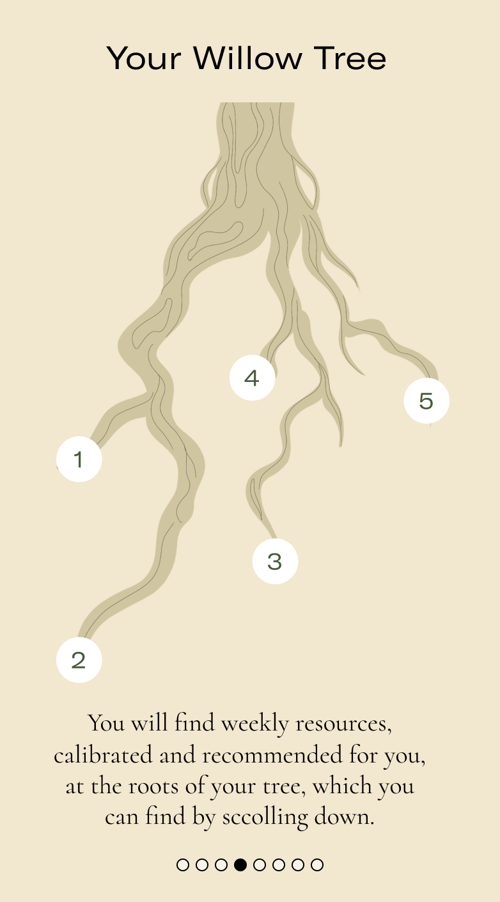
Onboarding flow

Slide 20
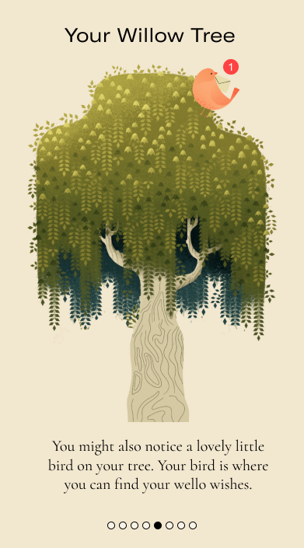
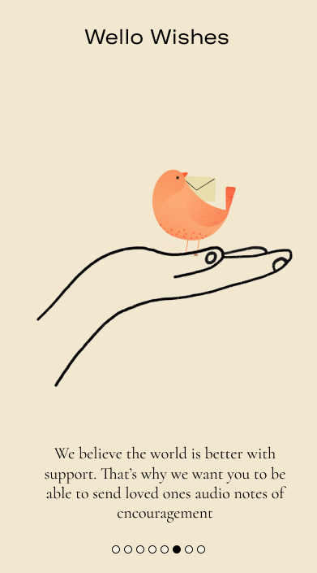
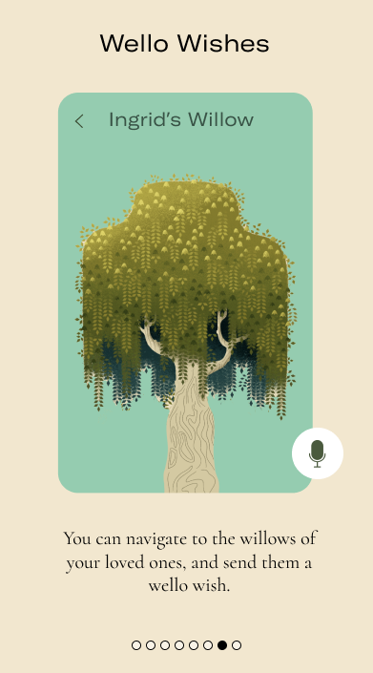
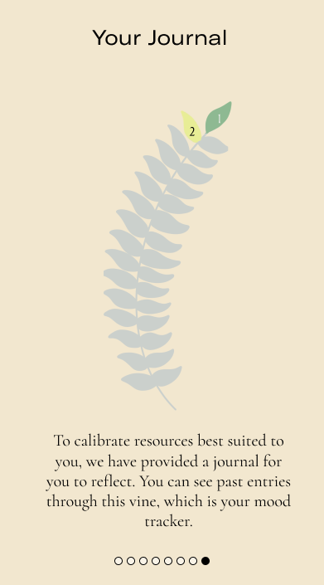
Onboarding flow

Slide 21
Color legend for mood tracker

Slide 22
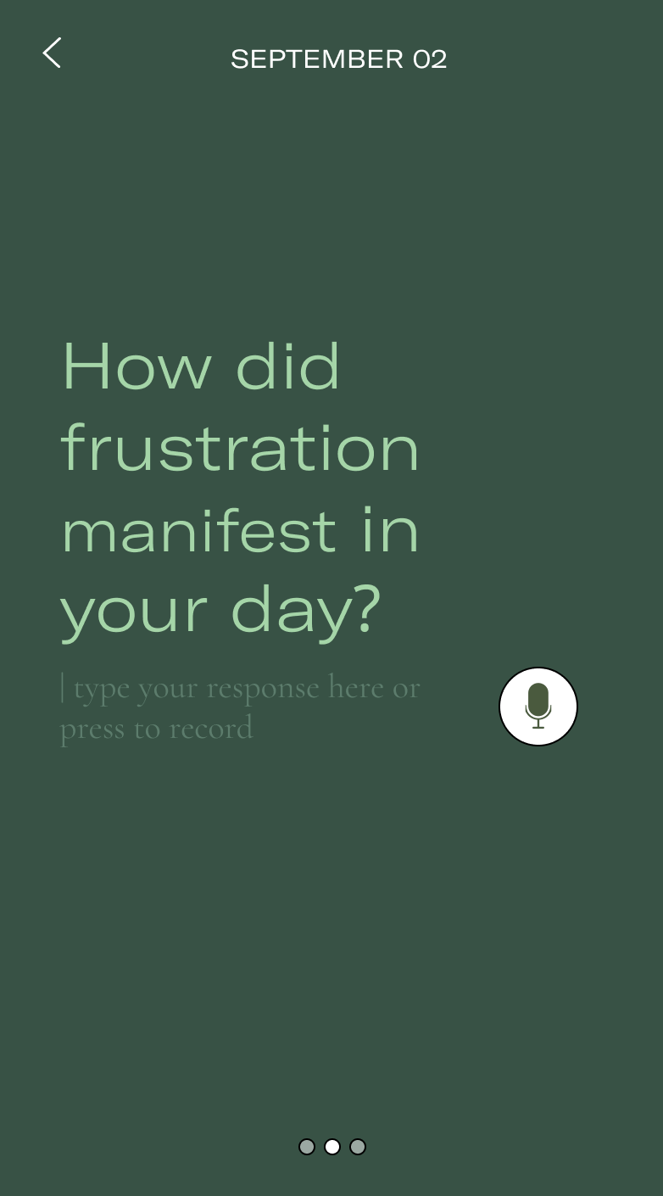
Option to voice record journal entries

Slide 23
05
Application of AI

Slide 24
Personalized resource recommendations
Applying NLP + ML to recommend wellness resources and events based on your journal entries

Slide 25
Personalized resource recommendations
Applying NLP + ML to recommend wellness resources and events based on your journal entries
“missed a section”
“ended up turning it in late”
“plans… that ended up getting canceled”

Slide 26
Personalized resource recommendations
Applying NLP + ML to recommend wellness resources and events based on your journal entries
“missed a section”
“ended up turning it in late”
“plans… that ended up getting canceled”

Slide 27
Questions?

Slide 28
Appendix

Slide 29
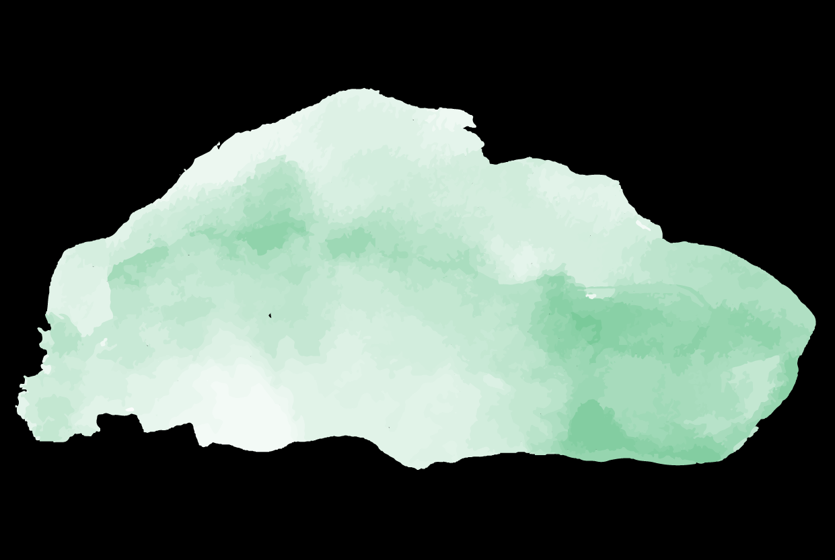
User Study Discussion Guide
User Test Summary
Med-fi Prototype (Figma)
Med-fi Prototype (Maze)

